Slide 1


The Long Wait is Over….DIGGS is Here
Robert C. Bachus, Ph.D., P.E., D.GE,
Senior Principal, Geosyntec Consultants, Kennesaw, GA
Silas Nichols, P.E.
Principal Bridge Engineer - Geotechnical
Federal Highway Administration
Washington, DC
47th Annual Southeastern Transportation Geotechnical Engineering Conference
Biloxi, MA
8 November 2016

Slide 2

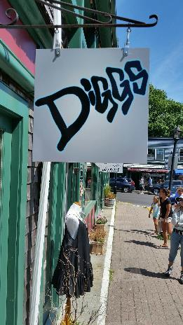

The Long Wait is Over…. DIGGS is Here
The long drought is over……
For the Chicago Cubs
For the DIGGS Community
www. ESPN.com
Bar Harbor, Maine
(2016)
www. MiLB.com

Slide 3
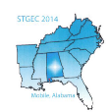
DIGGS: A Dream Becomes Reality: Implementation Status
Robert C. Bachus, Ph.D., P.E., D.GE,
Principal, Geosyntec Consultants, Kennesaw, GA
Robert Schweinfurth, P.E.
Director, Geo-Institute of ASCE
Reston, VA
45th Annual Southeastern Transportation Geotechnical Engineering Conference
Mobile, Alabama
28 October 2014

Slide 4
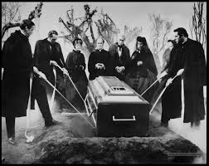

Presentation Organization
What is DIGGS?
Why DIGGS is Important for You?
How DIGGS Will Work?
DIGGS, FHWA, and Geo-Institute
Your Critical Role in DIGGS
www.theblackboxclub.blogspot.com
Standardized Geotechnical Data
Bury that Sucker…not interested
Only Heaven Could be Better
With your help, we believe that the latter will be a reality!
www.thebeausejourpulpit.wordpress.com

Slide 5
This Afternoon’s Agenda
We are in the midst of a major paradigm shift within our profession and we applaud the 2016 STGEC Organizing Committee for its insight and support
The Long Wait is Over…DIGGS is Here
  Robert Bachus and Silas Nichols – On behalf of the Geo-Institute and FHWA
Single Source Data Entry via Data Interchange
  Scott Deaton - Dataforensics
Information Modeling Systems
  Nicholas Loubier - Bentley
Three different presentations…all focused on geotechnical data management!

Slide 6

Geotechnical Data Management
The Problem… Big Data
www.clap.com
Big data is a broad term for data sets so large or complex that traditional data processing applications are inadequate. Challenges include analysis, capture, data curation, search, storage, transfer, visualization, and information privacy. (after Wikipedia.com)

Slide 7




Big Data…Big Standardized Data….
Big Fat Hairy Deal!
Red-headed Step Child
Overwhelmed
www.quotesgram500.com
www.goingconcern.com
Bewildered
Just Plain Boring!
www.pinterest.com
www.thetelegraph.com

Slide 8
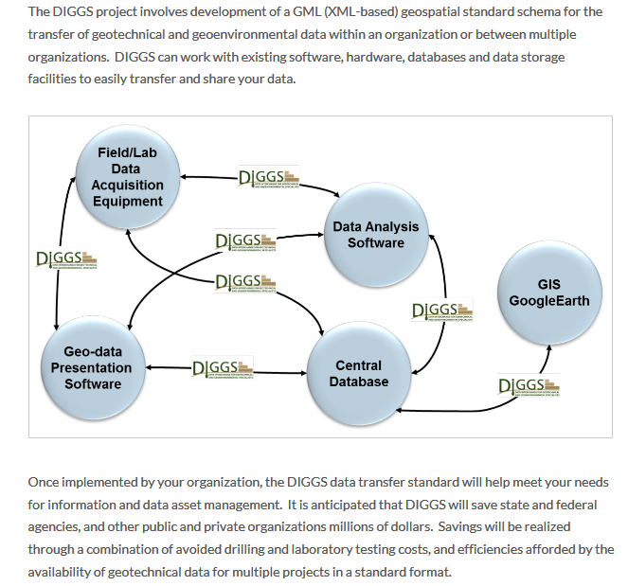
1. What is DIGGS? (www.diggsml.org)
Imagine a world where you do not have to cut and paste seven different times to get your “data” ingested
Very Important
DIGGS is NOT a database.
DIGGS is how you get data into and out of a database.

Slide 9
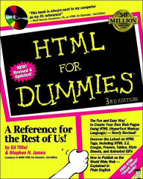
What is DIGGS?
DIGGS is to Geotechnical Data what HTML is to the Internet
Two Important questions:
As long as your browser works and you can navigate through the internet, do you really care what HTML is all about?
Do you need to understand what HTML is to use the internet?
www.barnesandnoble.com

Slide 10
Example HTML Code
Tags
<HTML>
<HEAD>
<TITLE>Your Title Here</TITLE>
</HEAD>
<BODY BGCOLOR="FFFFFF">
<CENTER><IMG SRC="clouds.jpg" ALIGN="BOTTOM"> </CENTER>
<HR>
<a href="http://somegreatsite.com">Link Name</a>
is a link to another nifty site
<H1>This is a Header</H1>
<H2>This is a Medium Header</H2>
Send me mail at <a href="mailto:support@yourcompany.com">
support@yourcompany.com</a>.
<P> This is a new paragraph!
<P> <B>This is a new paragraph!</B>
<BR> <B><I>This is a new sentence without a paragraph break, in bold italics.</I></B>
<HR>
</BODY>
</HTML>
Tags
Tags
Tags
Tags
HTML
Data entries are identified by “tags”
Specific rules are developed for the code
You never have to worry about these!
Tags
Tags
Tags
Tags

Slide 11






Data Transfer is Part of Our Life
(after Keynetix, 2014)
Web Servers
Browsers
Firefox
Chrome
Internet Explorer
Safari
Notes:
This is not a new concept
4 popular web browsers talking to 2 popular web servers.
Do they talk like this – NO …..
Concept of Web to exchange is about 1984
In 1989 the idea of hypertext was introduced
In January 1993 there were 50 web servers; by October 1993 there were 500
Bill Gore 1993 web browsers
1991 Hypertext first referenced. 1995 HTML 2.0

Slide 12





Data Transfer is Part of Our Life (>1995)
(after Keynetix, 2014)
Data Transfer Standard
(HTML)
Firefox
Chrome
Internet Explorer
Safari
Notes:
They talk like this….
Server = IIS and Apache
Browser – IE, Etc.

Slide 13
What is HTML?
HTML or HyperText Markup Language is the standard markup language used to create web pages
The purpose of a web browser (i.e., Internet Explorer) is to read HTML documents and compose them into visible or audible web pages
The browser does not display the HTML tags, but uses the tags to interpret the content of the page. HTML describes the structure of a website semantically along with cues for presentation, making it a markup language rather than a programing language
<!DOCTYPE html>
<html>
<head>
<title>This is a title</title>
</head>
<body>
<p>Hello world!</p>
</body>
</html>
Example of HTML Code
(after http://en.wikipedia.org/wiki/HTML )

Slide 14

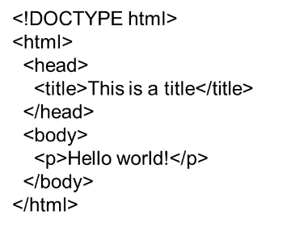

Data Transfer Using HTML
So here is the HTML Markup
So I ask again:
  As long as your browser works and you can navigate through the internet, do you really care what HTML is all about?
  Do you need to understand what HTML is to use the internet?
www.gbatemp.net
www.leandroesc.wordpress.com

Slide 15
Geotechnical Data Transfer Using DIGGS
KeyLAB
Excel
AutoCAD Civil 3D
Data Transfer Standard
(DIGGS)
HoleBASE SI
gINT
In house DB
(after Keynetix, 2014)
Notes:
It makes software fully software programs fully compatible without having to know anything about the other programs
Including your own in-house solutions.
The latest version of this transfer format is called DIGGS

Slide 16
Example PHP Output from DIGGS File
“What is in My DIGGS File”
 | XML Content Summary
Project Name - Dewey Dam
Borehole - BH-38
Count of Sampling Activities: 14
Test Type | Count
DrivenPenetrationTest | 8
SieveAnalysis | 1
Hydrometer | 1
AtterbergLimitsTest | 1
SpecificGravityTest | 1
LabDensityTest | 1
LabCompactionTest | 1

Slide 17

2. Why is DIGGS Important to You and Your Agency?
Why is Data Management and Communication Important?
It represents good practice
It shows that we are progressive
It will make my job easier…eventually
……
www.diggsml.org

Slide 18
Requirements for Data Management are Coming Soon
Geotechnical Asset
Physical Asset
Corridor and/or GAM Section
Non-Corridor
Non-Physical Asset
Data
Knowledge
Equipment
ROW Feature
Outside-ROW Feature
Material Sites
Stockpiles or other
Independent Feature
Element of other Structure
Bridge Element
Tunnel Element
Pavement Element
Slopes
Water bodies
Structures (walls, etc.)
Slope
Embankment
Subgrade
Earth Retaining Structure
Rock
Soil
Modified
Rock
Soil
Modified
Rock
Soil
Modified
Stabilized Earth
Steel or Reinforced Concrete
FHWA’s Proposed Geotechnical Asset Taxonomy
Predominant distinction in how feature is managed. Features with inclusions are “modified”.
Bottom Line: Data management may not be an option

Slide 19
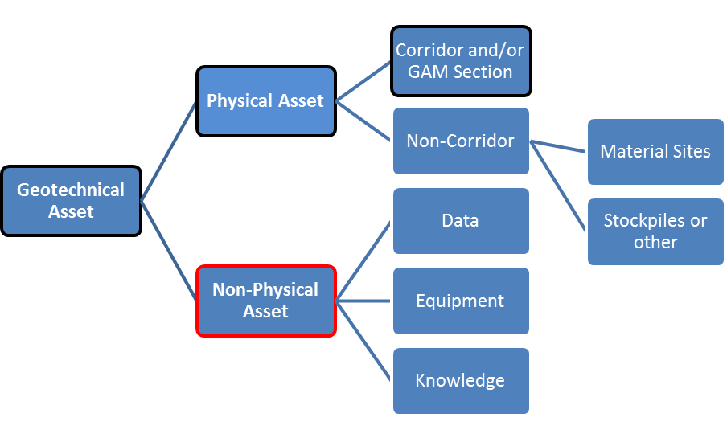
Requirements for Data Management are Coming Soon
Physical Assets along a Specific Corridor
Silas will soon identify the short- and long-term goals of FHWA, so be forewarned!

Slide 20
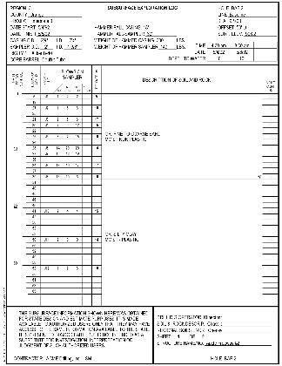
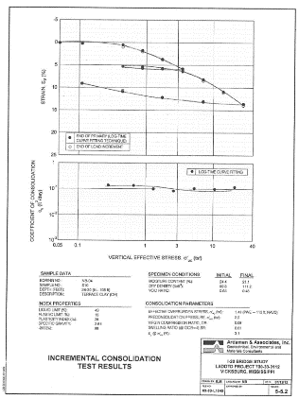
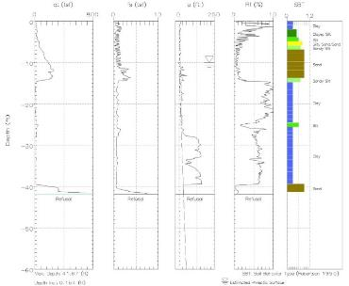
If It Is Only on Paper or .pdf File…… It Ain’t Data
What are Data?
The “old school” and “status quo” will simply be unacceptable in the future
Scott will address this in the next presentation

Slide 21
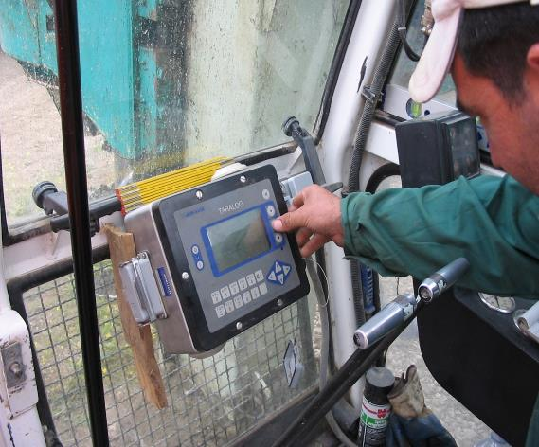
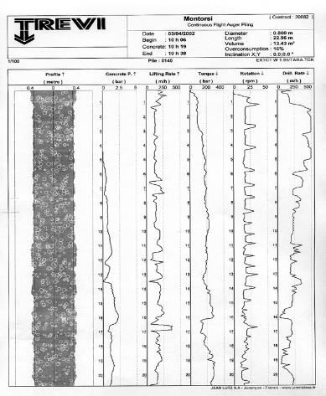
Contractors May be Ahead of Us!
What are Data?
Contractors currently are using “data” to help their operations AND for project QA

Slide 22
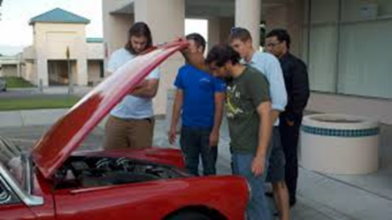
3. How Will DIGGS Work?
Ø
DIGGS utilizes an XML and GML format…… recall analogy to HTML
Somebody has to be looking under the hood
But It is NOT You
Your
Standard
Data File
Convert to a “standard” spreadsheet-like template
DIGGS Committee
Data Dictionary and Schema
Output
Software Vendors
(Our new best friends)

Slide 23
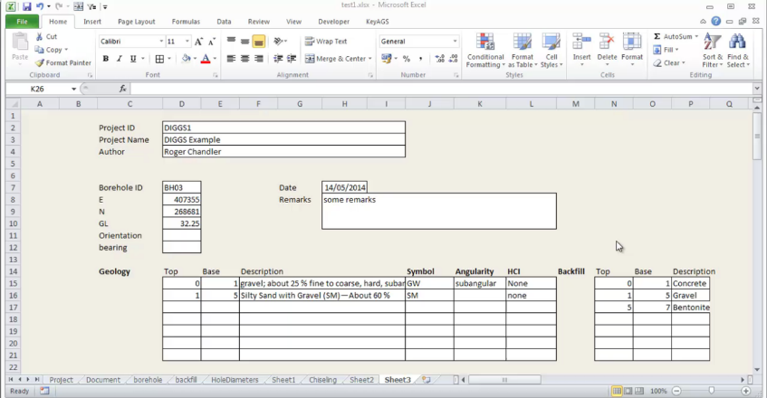
User Friendly
Example Standard Boring Log Input
Provide tool to get your boring log to look like this…automatically
If it looks like this, it will generate a DIGGS file… automatically

Slide 24
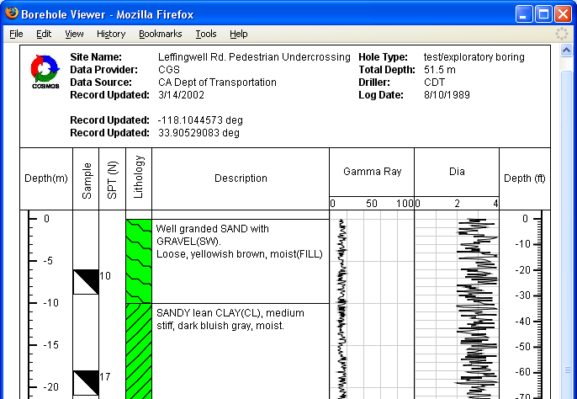
Example Standard Boring Log :
COSMOS
Data (and Boring Log) can be instantly transferred across the web

Slide 25
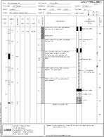
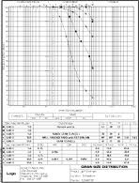
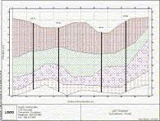
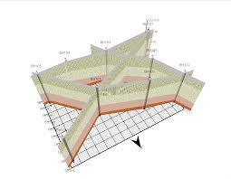
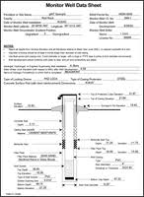
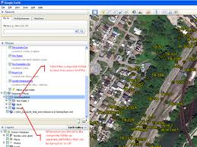
Software Tools to Follow…. This is Key to Success
Boring Logs
Lab Test Report
Fence Diagrams
Completion Details
3-D Graphics
GIS Interface
www.scientificsoftwaregroup.com/
www.bentley.com/

Slide 26

4. DIGGS, FHWA, and the Geo-Institute
Innovative Collaboration
We recognized the problem
We recognized the opportunity
We found a solution in DIGGS
www.Quotesgram.com
Peter Drucker (2012)

Slide 27


We Have Models the Help Guide Our Efforts
http://ags.org.uk/data-format
In 1991, the AGS set up a method for transferring data between industry organizations. This is known to many simply as ‘AGS Format’ or ‘AGS Data Format’ and provides a standard way to transfer ground investigation, laboratory testing and monitoring data between the contributing parties of a project which involves geotechnical or geoenvironmental elements.
Put simply:
“The AGS Data Format allows for seamless sharing of data between different software used within the geotechnical/geoenvironmental industry”.
https://www.nzgd.org.nz /
The New Zealand Geotechnical Database (NZGD) is an online database that provides a searchable repository for new and existing geotechnical information. It builds on the success of the Canterbury Geotechnical Database (CGD), which was developed for the Christchurch rebuild following the 2010/2011 Canterbury earthquake sequence. It also incorporates data previously held on the Auckland Geotechnical Database, which was initially set up by Watercare

Slide 28
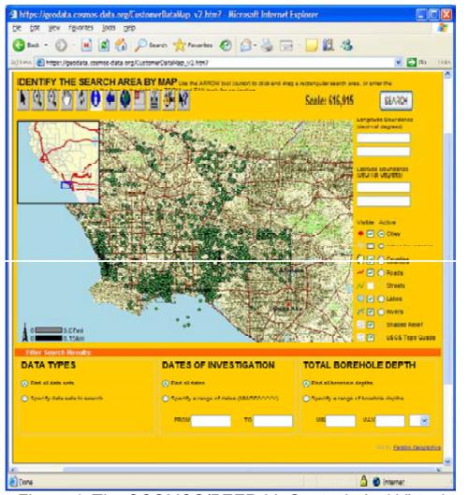
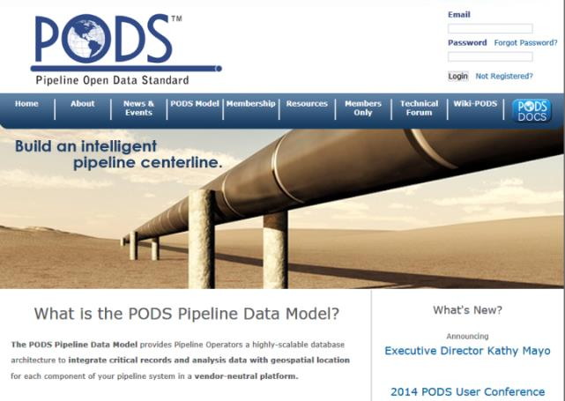
We Have Even More Models to Guide our Efforts
Standard Format and Business Model
Geotechnical Virtual Data Center

Slide 29
Status and Opportunities for Support and Participation
Data Dictionary and Schema Developed for >40 Tests
  Need community support to QA the test input models
DIGGS Feedback Tool Developed to Automatically Develop DIGGS Files
  Need community support to QA the test input models
Final Report Submitted to Ohio DOT
Solicit Commitment from Organizations
  Private and public organizations
  Seek R&D funding to advance DIGGS 2.0
  Establish Web “blog” to communicate and inform
  What are “next generation” DIGGS files
Work with Software Vendors to Support DIGGS
  Ongoing positive response, but we need you
Develop Training Materials
  Feedback Tool and PHP applications are “band-aids”
Log in for more information
www.diggsml.org

Slide 30

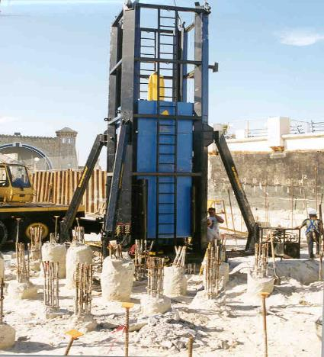
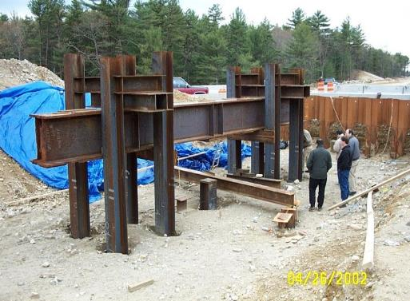

Ideas for Future
Data Beyond Current DIGGS
Literally, the sky will be the limit
Innovate and Create the Future

Slide 31
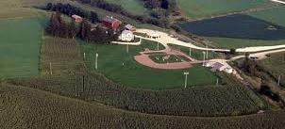

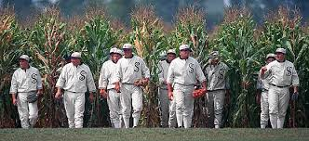

5. Your Critical Role in Success of DIGGS
Field of Dreams (1989)
We will Make DIGGS User Friendly and Provide Quantifiable Benefits
Software Vendors Will Help if They are Confident of Owner Support
WILL THEY COME ?
You hold the key!
http://speakoutsarasota.com
http://franklymydearmojo.com
Notes:
Kevin Costner, Dubuque County, Dyersville, Iowa

Slide 32

Planning for the Future
FHWA
Develop guidance and education for:
  Management of Geotechnical Information
  Communication of Geotechnical Information
Advocate research on “Big Data” management
Promote DIGGS as transfer protocol for communication of geotechnical data
Geo-Institute
Solicit support and participation from public and private organizations
Identify a sustainable business model to ensure growth
Establish committees to help future development
Solicit software vendor support
DIGGS

Slide 33


We Are Ready for You
www. blog.sina.com.cn
We believe that DIGGS will be successful if you support it
We
the DIGGS Team
The recruiters are here and standing by today!
If for some reason you have reservations about support, please contact us
www.SayWhyDoI.com

Slide 34


Conclusion
www.cyber8technologies.com
DIGGS is Ready….but
The Transformation from Ho-Hum
www.dreamstime.com
to Unbridled Excitement Depends on You

